Slide 1




American International University Bangladesh
Traffic Light Control
Using 555 Timer & CD4017
Course: Digital Logic Circuit Lab
Instructor: Samiha Ishrat Islam
Group Members:
ASHIFUL ISLAM NABIL : 24-55928-1
SHEIKH MAHFUZUR RAHMAN :
24-55917-1
JAKARIA ISLAM RAAD :
24-55949-1
MOHAMMED ALI KHORASANI :
24-55920-1
NITOL KUNDU: 22-48169-2
ASHIQUR RAHMAN : 24-55921-1

Slide 2


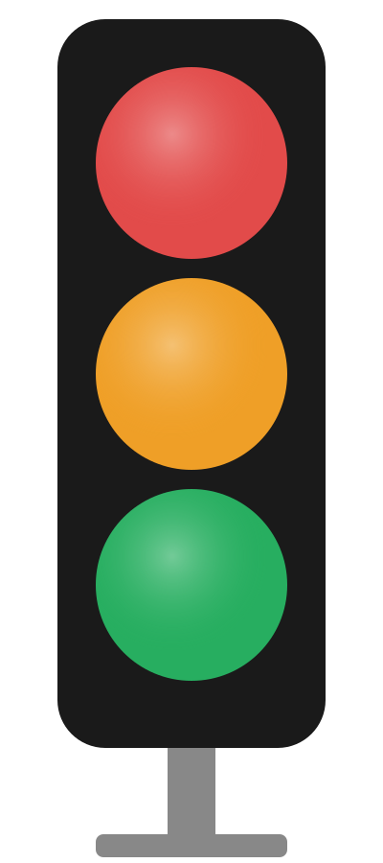


Problem Statement & Objective
Member 1 | Slide 2
THE PROBLEM
OUR OBJECTIVE
Manual Traffic Control
Design Automated Traffic Light
Police officers control traffic manually — slow, tiring and error-prone during busy hours.
Build a traffic light that automatically cycles Red → Yellow → Green using hardware only.
Inefficient Flow
No Code / No Microcontroller
Without proper timing, vehicles pile up causing traffic jams and road accidents.
Use pure Digital Logic Circuit (DLC) approach — only ICs, resistors, capacitors and LEDs.
No Fixed Timing System
Timer + Counter Theory
No consistent signal timing means unpredictable stops, wasting fuel and driver time.
Apply 555 Timer IC (astable mode) and CD4017 Decade Counter to control timing and light sequence.

Slide 3
How the System Works: Logic View
Sequential Logic Circuit :
The system operates as a Finite State Machine (FSM) where states change based on a clock trigger.
Output depends on the current state and the incoming pulse.
Clock Signal ( 1Hz Pulse ) :
Uses a 1Hz continuous square wave (1 pulse per second) for timing synchronization.
Counter-Based State Control :
CD4017 Decade Counter sequences through 10 distinct states (Q0–Q9).
Only one output is HIGH at a time, shifting step-by-step with each pulse.

Slide 4
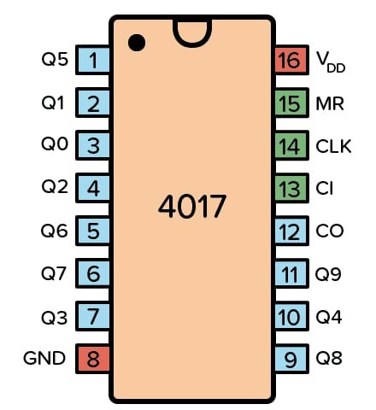
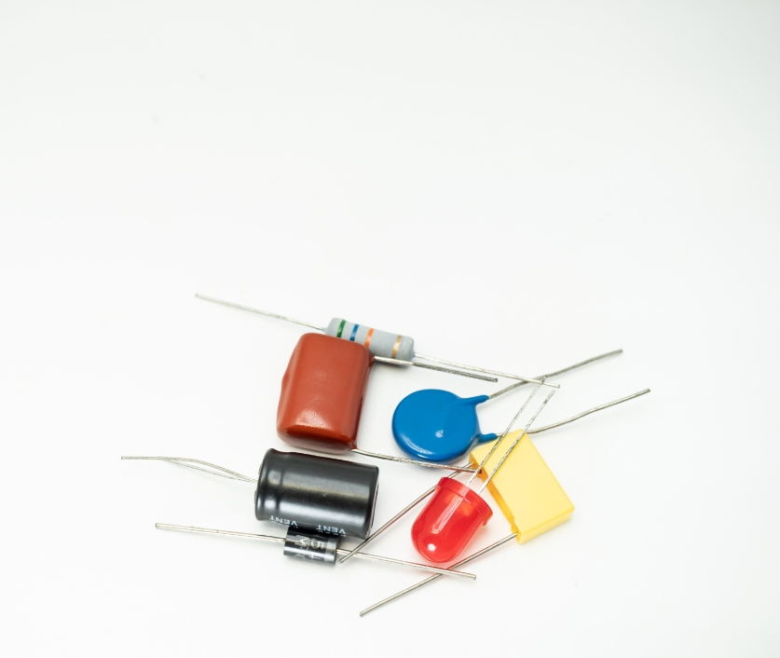
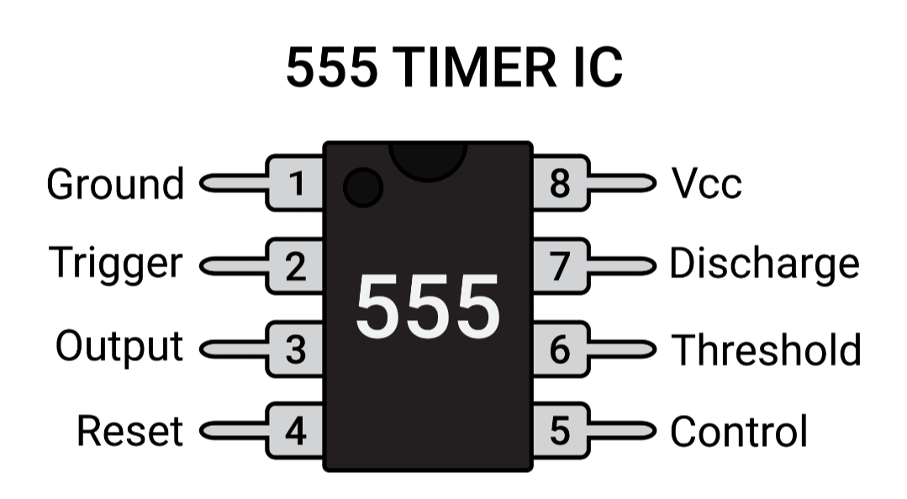
Apparatus
555 Timer IC
CD4017 Counter IC
LEDs (Red, Yellow, Green)
Resistors, Capacitors
Breadboard & Power supply

Slide 5
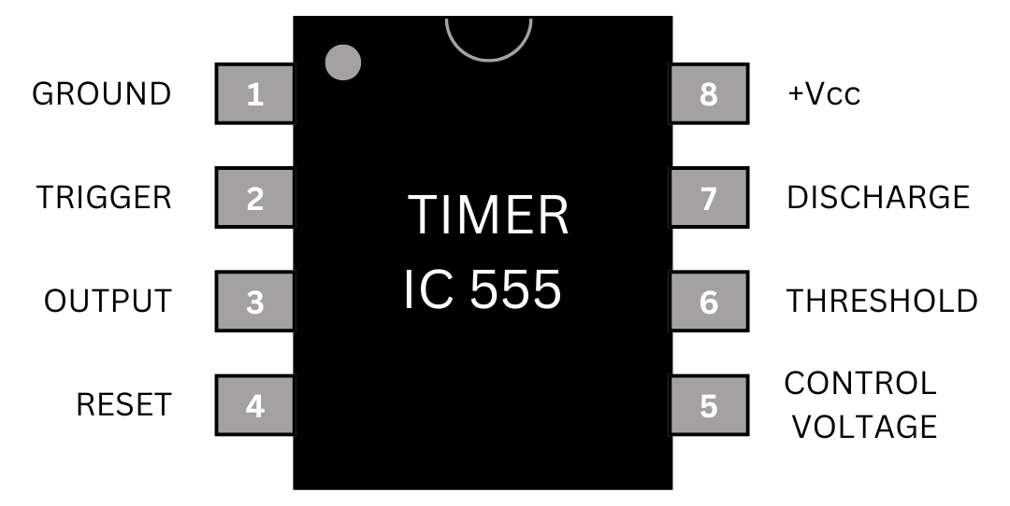
555 Timer Working
Astable mode operation
Generates continuous clock pulses
1 second interval
Acts like the heartbeat of the circuit
It continuously sends timing signals to control the circuit

Slide 6

CD4017 Counter Working
Decade counter (Q0–Q9)
One output HIGH at a time
Moves step-by-step with clock
Shifts output from Q0 → Q1 → Q2 →… → Q9 → Q2
Each clock pulse activates the next output

Slide 7

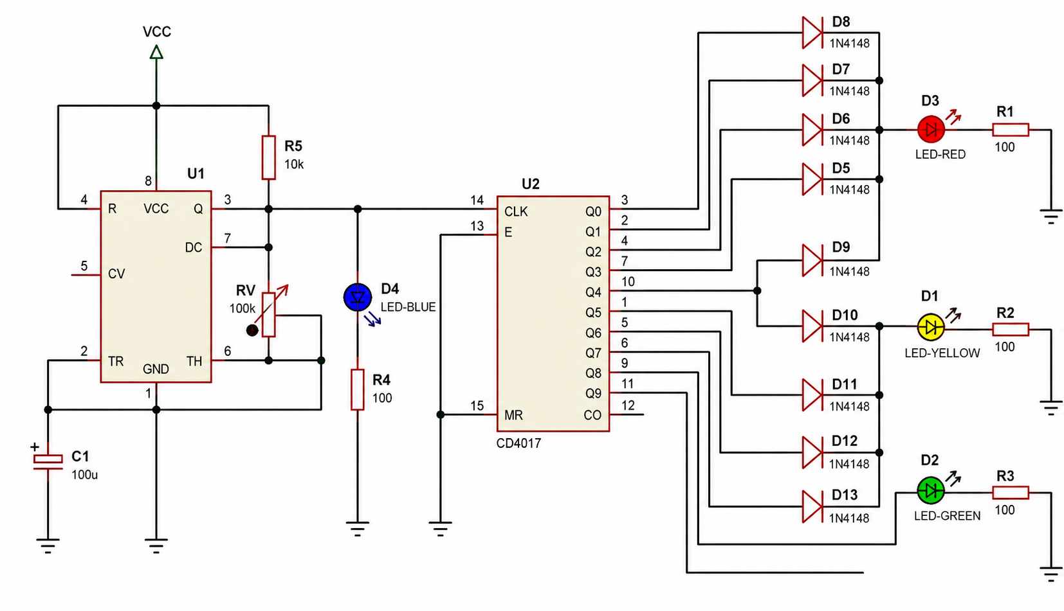
Circuit Design:

Slide 8
Breadboard Implementation:
Implementation:
• 555 Timer generates clock pulses (~1 sec)
• Output connected to CD4017 clock input
• Counter outputs drive LEDs
LED Mapping:
• Q0–Q3 → 🔴 Red
• Q4–Q7 → 🟢 Green
• Q8–Q9 → 🟡 Yellow
Key Points:
• 5V DC power supply
•Proper pin connections
•Resistors used with LEDs
•Capacitors ensure stable timing

Slide 9
Result & output :
Output Sequence:
RED → GREEN → YELLOW → Repeat
Timing:
🔴 RED = 4 sec
🟢 GREEN = 4 sec
🟡 YELLOW = 2 sec
Result:
Fully automatic traffic control system
No manual switching required
Smooth traffic light transition
Low-cost and easy to build

Slide 10
Successfully designed an automatic traffic light control system using NE555 Timer and CD4017 IC
Achieved reliable sequential control of Red, Yellow, and Green lights
System operates automatically without manual intervention
Simple, cost-effective, and easy to implement
Suitable for small-scale traffic management and educational use
Provides practical understanding of timer and counter circuits
Conclusion

Slide 11

Thank you

